Slide 1
HYPERLOCAL ADVERTISING, REIMAGINED
Jeeran Network
One neighborhood. One QR stand. Offers that follow the customer home.
AUGUST 2026

Slide 2
THE PROBLEM
Small shops can't compete for attention
● Digital ads are built for national brands, priced for national budgets.
● A neighborhood coffee shop can't outbid a chain for the same customer.
● Loyalty apps require a download most customers will never make for one shop.
● The most valuable audience — people already walking past — is the hardest one to reach with a message that actually lands.
⚠️ What shops are left with
Flyers, word of mouth, and expensive platforms built for someone else's business model — while the shop next door has exactly the customers they need.
JEERAN NETWORK
2

Slide 3
THE SOLUTION
One shared customer wallet, for every shop in the network
A customer scans any participating shop's QR stand once — and saves ONE wallet pass that then surfaces nearby offers from every other shop in the network, automatically.
📱 No app to install
It's a pass in the wallet the customer already has open every day.
🔒 No live tracking
Offers follow the customer using the phone's own on-device location — Jeeran never sees where they are.
⚖️ No pay-to-play
Placement is a real bid auction, with a loyalty tier that rewards genuine activity, not spend alone.
JEERAN NETWORK
3

Slide 4
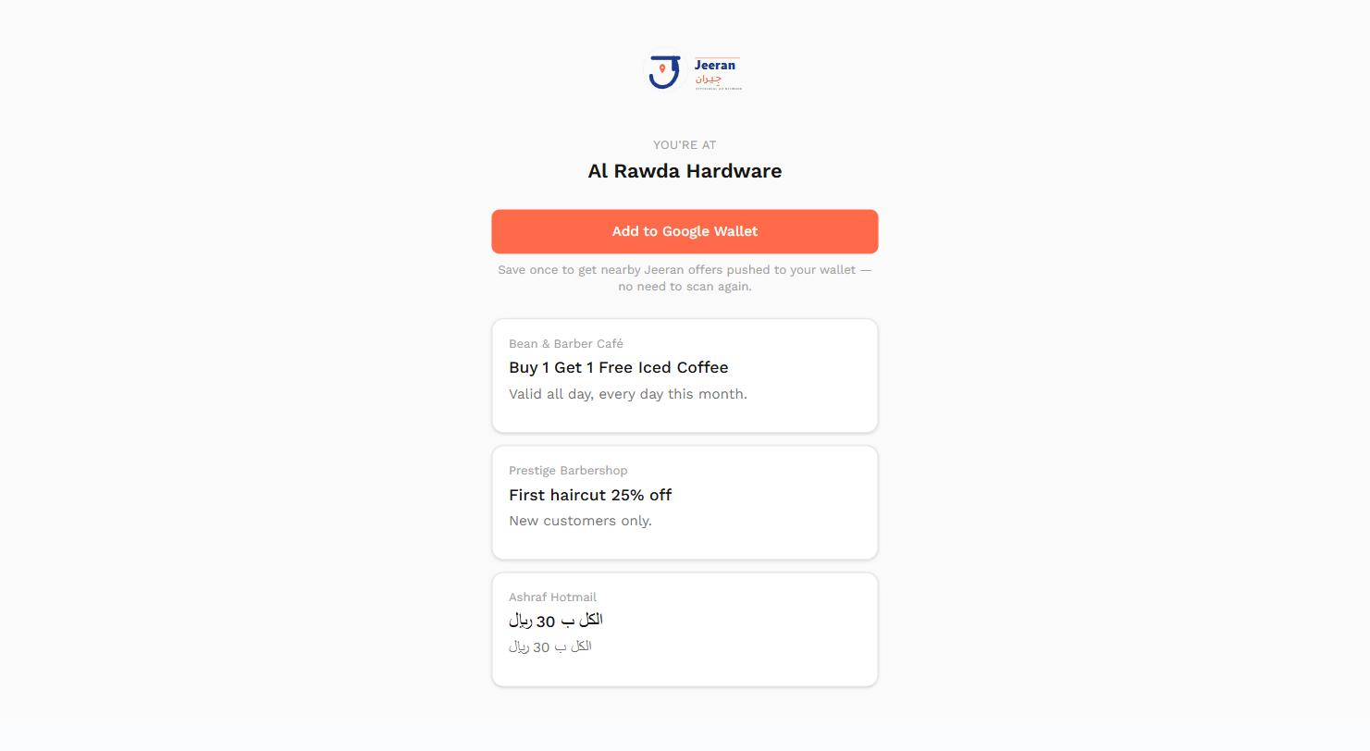
CUSTOMER JOURNEY
From a scan to offers that show up on their own
Scan the QR stand
See live nearby offers
Tap Add to Google Wallet
Warm confirmation
Offers keep arriving
● One save covers every future offer, forever.
● Card content refreshes the moment a nearby offer changes.
● Lock-screen alert for a genuinely new offer nearby.
● Shown in the customer's own language automatically.
JEERAN NETWORK
4

Slide 5
SHOP JOURNEY
From print-and-post to a ranked marketplace
Onboard & set up
Print your QR stand
Create a campaign (bid)
Appear on nearby shops' pages
Redeem & earn credit
🎯 Fair, contested placement
Never your own campaign, never a same-category competitor. Highest bid wins — your loyalty tier only breaks a genuinely close tie.
📈 Real acquisition, not just impressions
Earn credit for recruiting a new customer, for repeat visits, and for every redemption your own offers drive — with a visible tier and a real milestone bonus when you level up.
JEERAN NETWORK
5

Slide 6
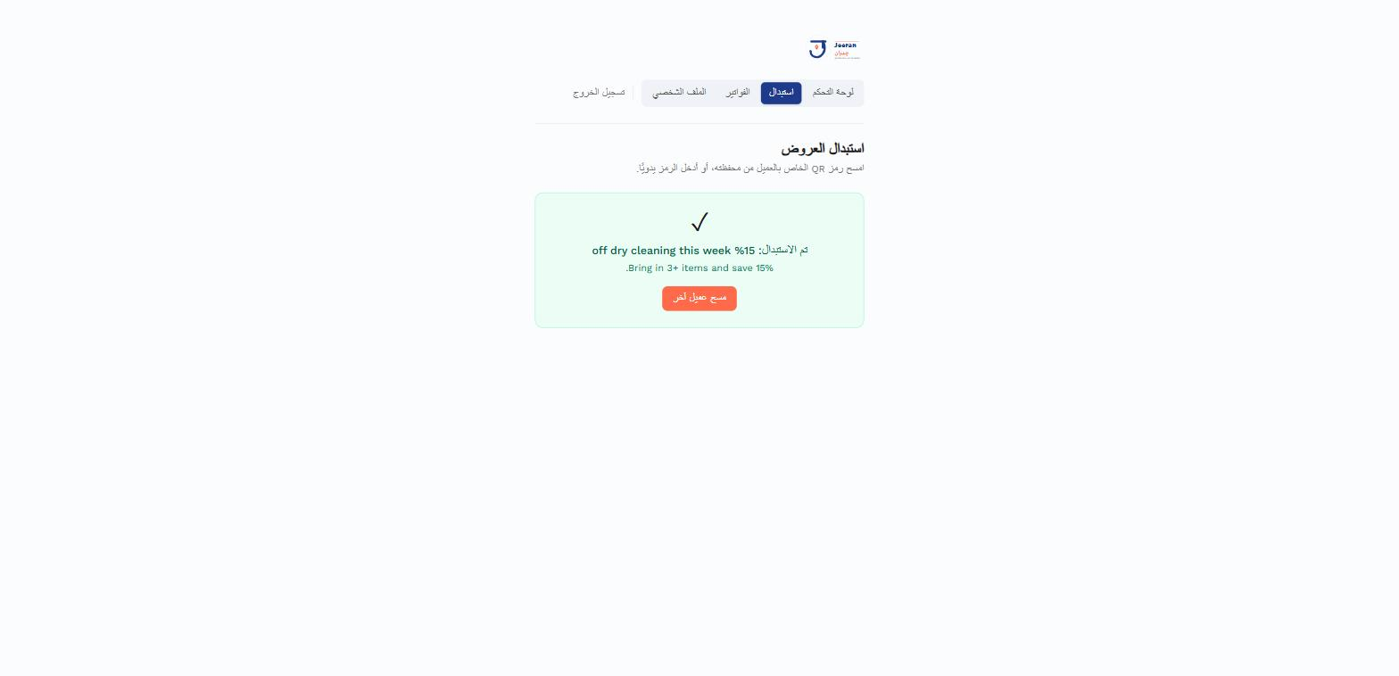
IN-STORE REDEMPTION
Staff scan, confirm, done
● Camera scan on any device — with a manual-entry fallback that always works, including on iOS Safari.
● The pass barcode is an opaque, signed token — never a URL, never guessable.
● Staff see exactly why a scan didn't work: no active offer, already redeemed, or a dead pass — not just a generic failure.
● A successful redemption instantly moves credit to the shop that originally recruited that customer, and checks whether it just pushed a shop into a new loyalty tier.
JEERAN NETWORK
6

Slide 7
LOYALTY TIERS
A visible reward for real, ongoing activity
🥉
Bronze
Everyone starts here
🥈
Silver
5 redemptions
🥇
Gold
20 redemptions
💎
Platinum
50 redemptions
🎉 Milestone bonus
A one-time credit the moment a shop crosses into a new tier — announced with a real on-dashboard moment, never a silent number change.
⚖️ Ranking edge, not a shortcut
Tier only decides ordering when two shops' bids are already close — a strong bid always wins outright, tier never overrides it.
JEERAN NETWORK
7

Slide 8
WHY JEERAN
Built for neighborhoods, not national budgets
Zero install friction — A Wallet pass, not another app — customers already carry it.
Privacy by design — No server-side location tracking — the OS delivers 'follows you' entirely on-device.
Fair placement — A real bid auction with loyalty as a tiebreaker, not a pay-to-win leaderboard.
Self-reinforcing network — Every new shop is both a new advertiser and a new discovery point for every other shop.
JEERAN NETWORK
8

Slide 9
Every shop is a stage.
Every neighbor is an audience.
Jeeran Network — advertising that stays local, follows the customer, and rewards the shops that earn it.

